Slide 1


N00014-16-1-2879: Bottom-up and top-down mechanisms of auditory scene analysis
PI: Joel S. Snyder, Ph.D.
Award start date: 8/1/16

Slide 2






Acknowledgments
Nathan Higgins, Ph.D.
Breanne Yerkes
Karli Nave
David Little, Ph.D.
Abin Kuruvilla-Mathew, Ph.D.
Mounya Elhilali , Ph.D.

Slide 3

Cocktail Party Problem
How do we hear in noisy situations?
Dai Dudu, Li Tiezi, and Zhang An, “Discussing the Divine Comedy with Dante” (2006)

Slide 4
Auditory scene analysis
In the 20th century, several scientists studied auditory stream segregation (or “streaming”)
Most notably, Al Bregman studied it extensively as a model of how we parse complex auditory scenes into objects and streams
Here, I’d like to focus on the more recently discovered fact that streaming stimuli are ambiguous (van Noorden, 1975)
Adapted from van Noorden (1975)

Slide 5
Visual and auditory multistability
Pressnitzer & Hupé (2006) showed that auditory stream segregation is bistable in a very similar manner as moving plaids
Also showed a marginal correlation (N=23) between switching behavior across senses
https://youtu.be/WhbZesV2GRk

Slide 6
Visual and auditory multistability
Kondo et al. (2011) studied a larger sample of participants (N=100) and showed robust correlations between streaming and various visual stimuli

Slide 7
Visual and auditory bistability
What explains cross-modality similarity and correlations in bistable switching?
Auditory and visual cortex work in similar manner but independently (Shamma, TICS2001)
Common association areas (frontal, parietal) are involved in perception across senses
Due to attentional systems that promote perceptual stability and change (Corbetta & Shulman, 2002)?

Slide 8

Intermittent streaming paradigm
We developed an intermittent auditory stream segregation paradigm in which three repetitions of a low-high-low pattern are presented, followed by a gap with enough time for participants to report their perception
N=30, Excluded participants with fewer than 20 switches

Slide 9
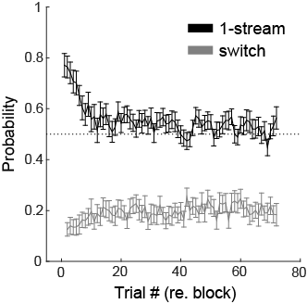
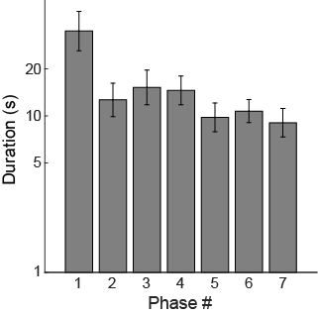
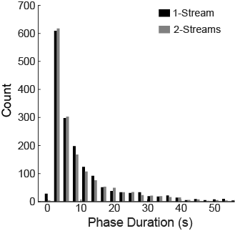
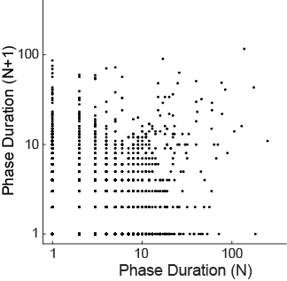
Intermittent streaming paradigm
Tendency to perceive one stream early on, switches to two streams later
Switch probability goes up slightly then stays the same
Behavioral data show similarities with Pressnitzer and Hupé (2006)

Slide 10
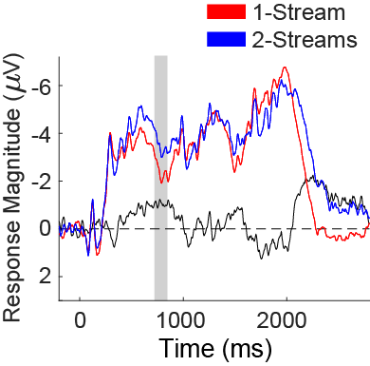
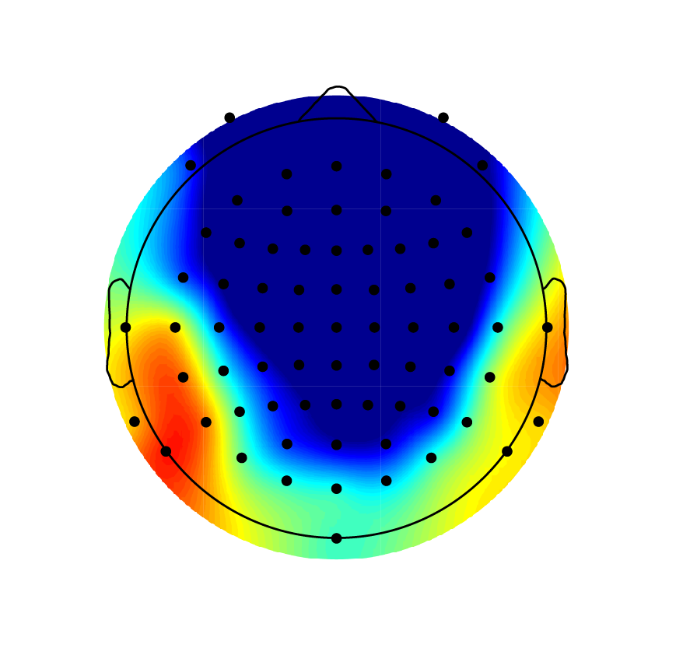
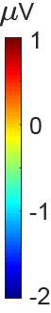
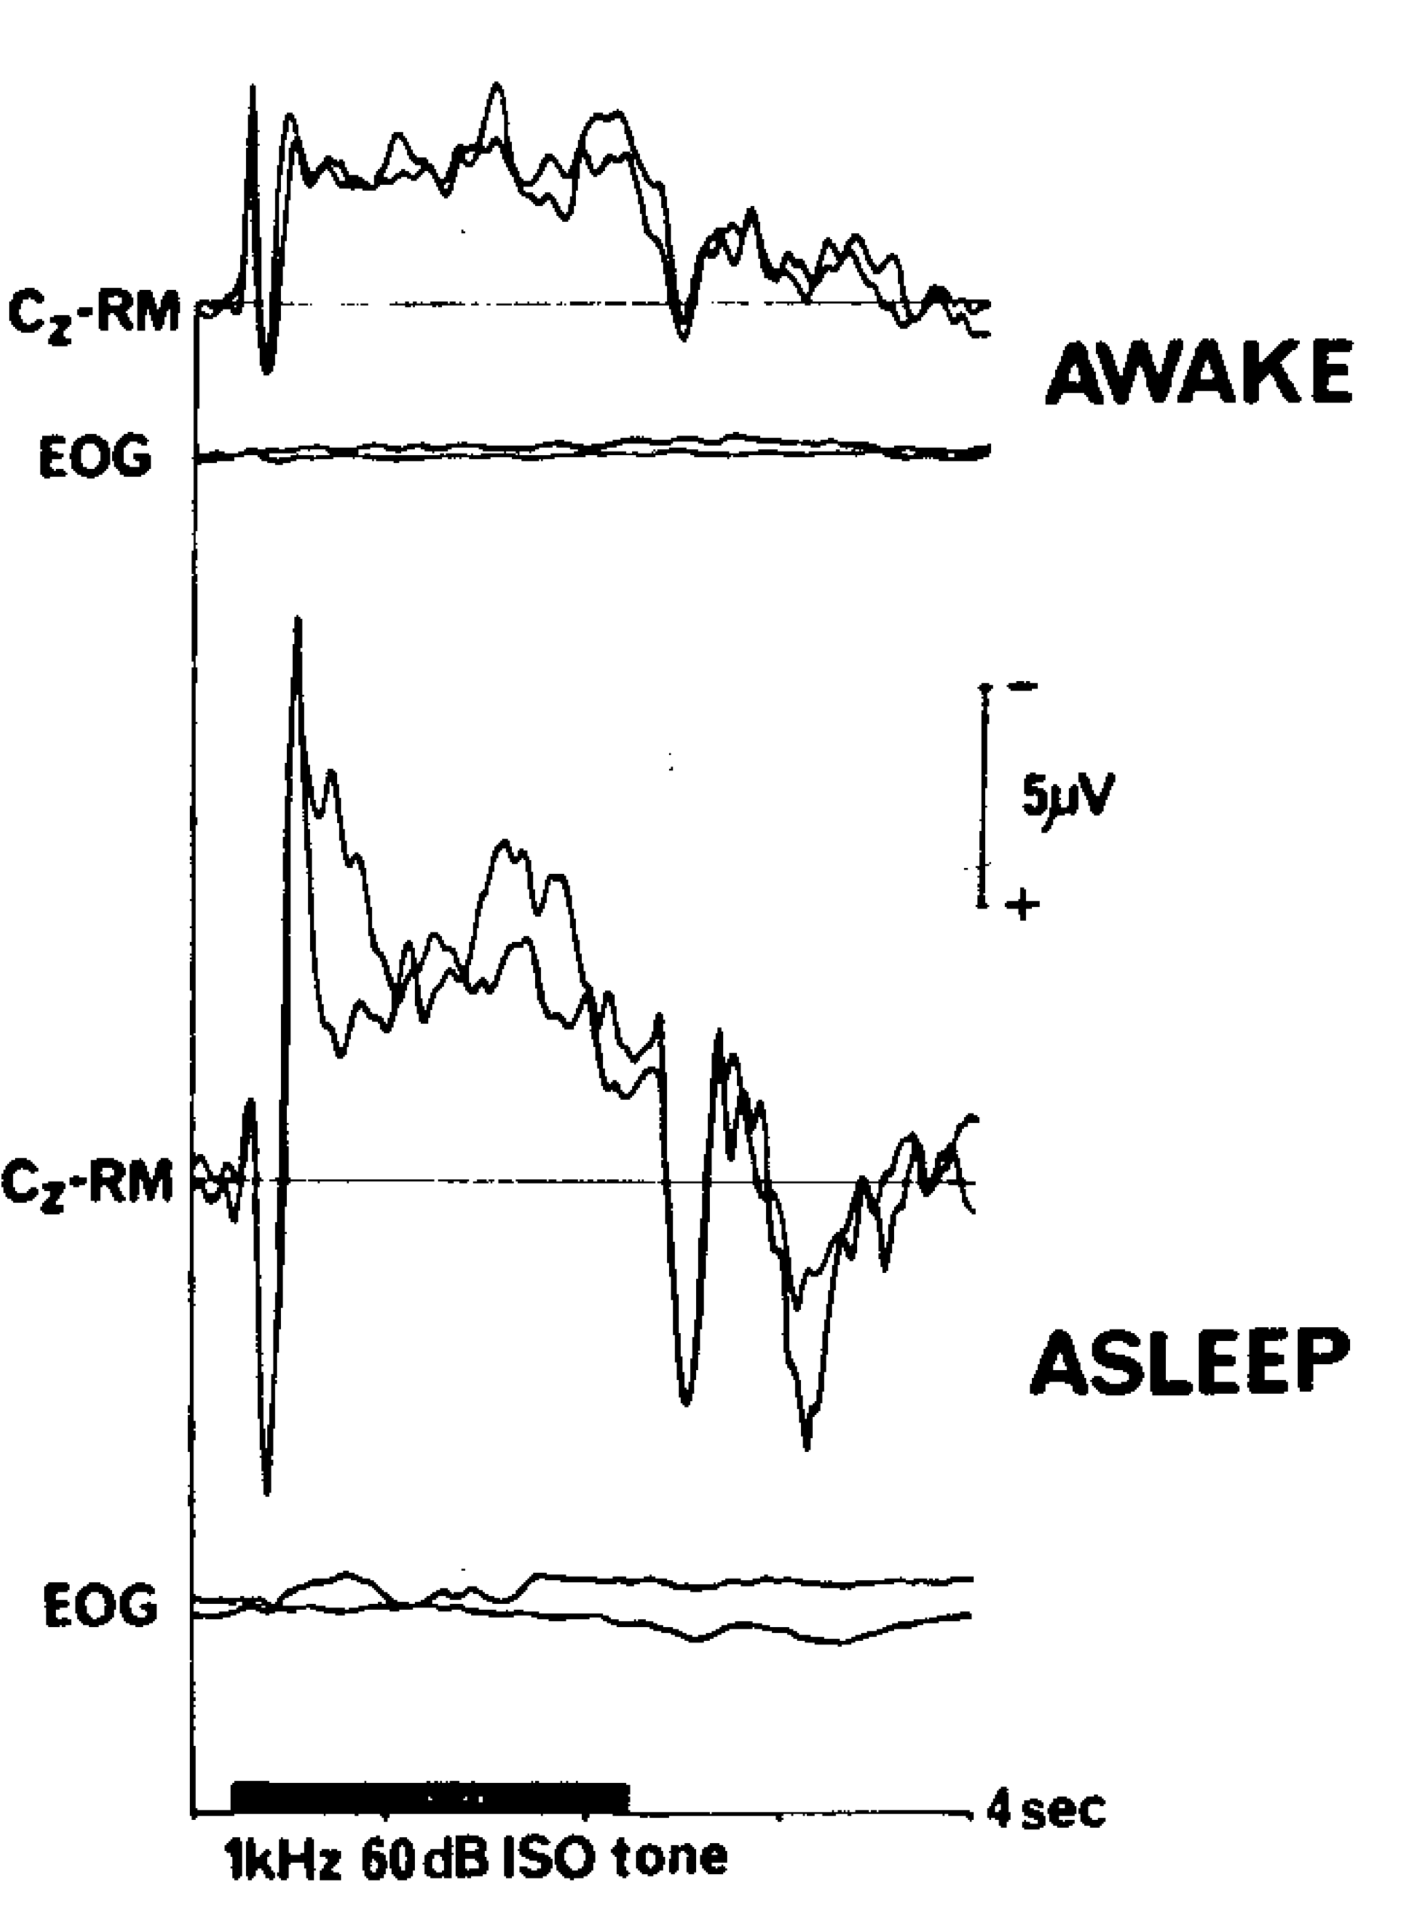
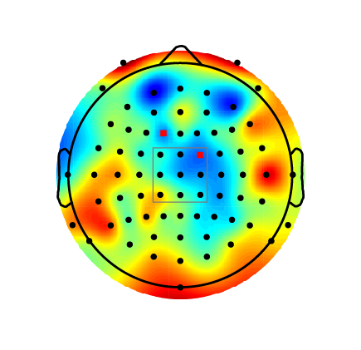
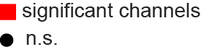
ERPs: 1 stream vs. 2 streams
ERP differences (shading) determined by contiguous differences at particular electrodes, using 1000-fold permutation analysis (Maris & Oostenveld, 2007)
Sustained negative potential is larger for two-stream trials than one-stream trials
Sustained potential observed for long-duration tones (Picton et al., 1978), even during sleep, and is therefore likely in part a sensory-level response
2 streams
Picton et al. (1978)
2streams-1stream

Slide 11
ERPs: 1 stream vs. 2 streams
Increased sustained potential could be due to top-down attention effects (Snyder et al., 2006)
Dividing attention between 2 streams or inhibiting un-attended stream?
Top-down attention needed to maintain perception of 2 streams (Carlyon et al., 2001; cf. Corbetta & Shulman, 2002)?
2streams-1stream
Snyder et al. (2006)

Slide 12
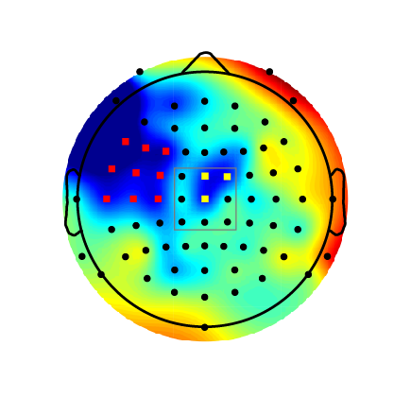
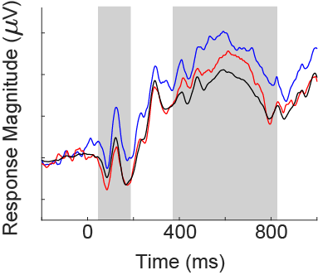
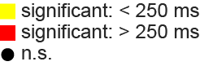
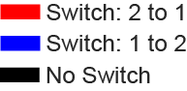
ERPs: Spontaneous switching
Switch trials do not show reversal negativity (RN), except for when switching from 1 to 2 streams
RN is significant at different electrodes than later difference
2to1-1to2
RN
Davidson & Pitts (2014)

Slide 13
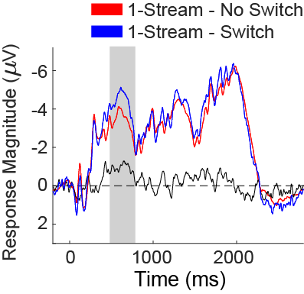
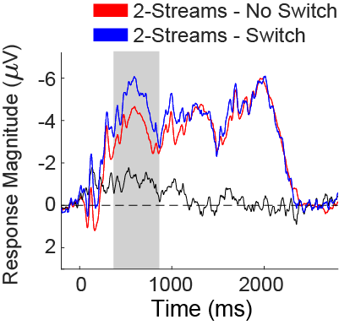
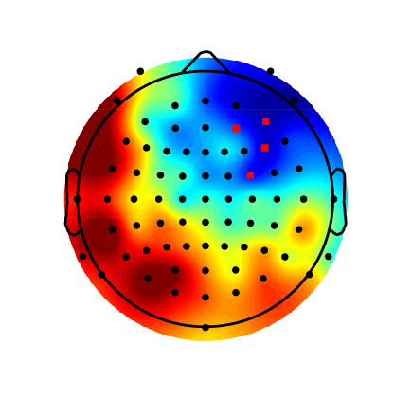
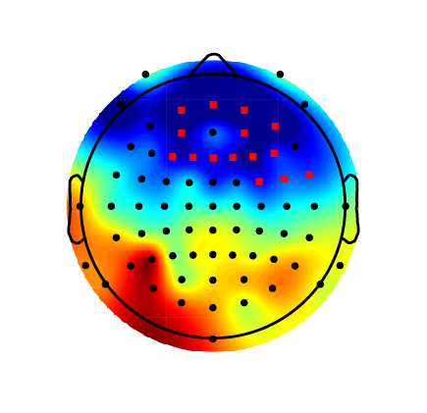
ERPs: Spontaneous switching
How much of switch-related activity is due to switching per se rather than perceiving 1 vs. 2 streams?
switch-no switch
switch-no switch

Slide 14
Preliminary source analysis: 2 streams vs. 1 stream
Bilateral dipoles in superior temporal lobe account for:
~85% of variance in sustained potential during perception of 1 stream and 2 streams (cf. Scherg et al., 1989)
Enhanced activity during perception of 2 streams compared to 1 stream
Scherg et al., 1989

Slide 15
Induced switching paradigm
Prior studies show that stimulus changes can ‘reset’ perception from 2 streams back to 1 stream
What roles do attentional capture vs. sensory processing disruption play in causing switches in perception?
Rogers & Bregman, 1998
Anstis & Saida, 1985
Changes in frequency range

Slide 16
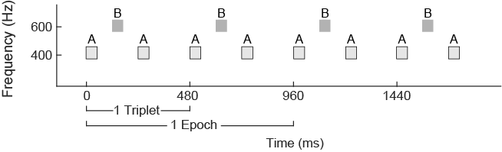
Induced switching paradigm
Continuous ABA- patterns presented in 7 min blocks with occasional distractors at one of four delays after 1st A tone onset (60, 180, 300, or 420 ms):
Visual distractor blocks: whole-screen flash of red, green, or blue on screen
Auditory distractor blocks: iterated ripple noise, with center frequencies of 1, 2, or 3 kHz
Distractors DID NOT overlap with frequency range of ABA, ruling out peripheral interference
noise/flash

Slide 17
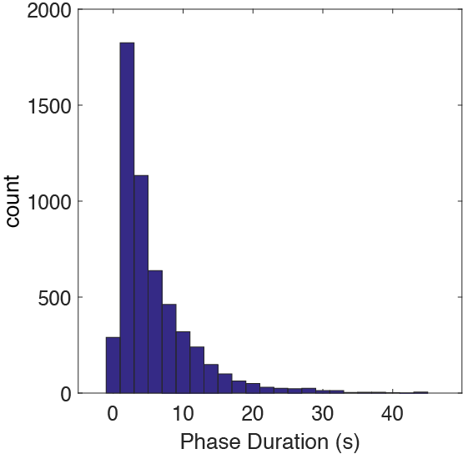
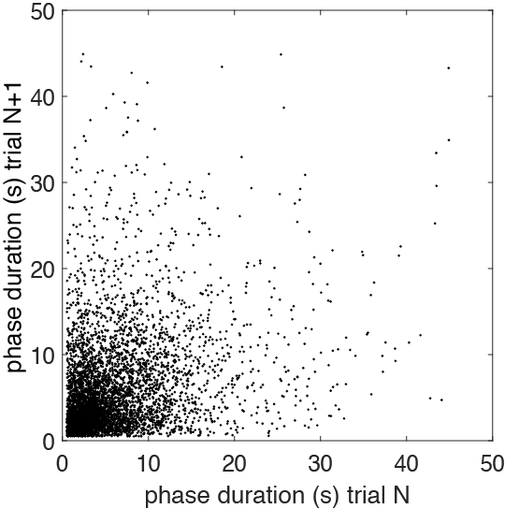
Induced switching paradigm
Bistable switching occurring as in intermittent experiment (N=15 so far)

Slide 18
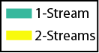
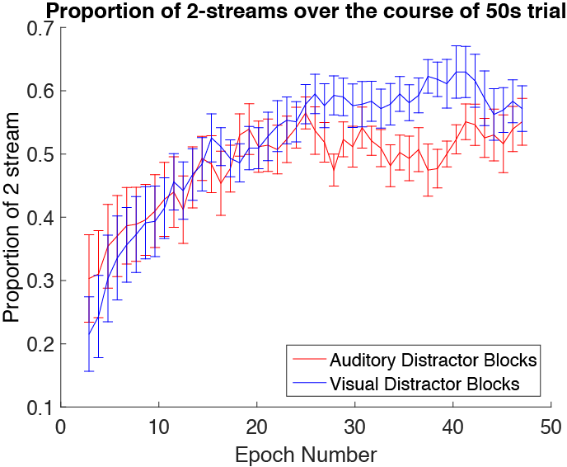
Induced switching paradigm
Less overall perception of 2 streams in blocks with auditory distractors starting around half way through block
Block Type
Auditory Distractor
Visual
Distractor
Auditory Distractor
Visual
Distractor
Auditory Distractor
Visual
Distractor

Slide 19
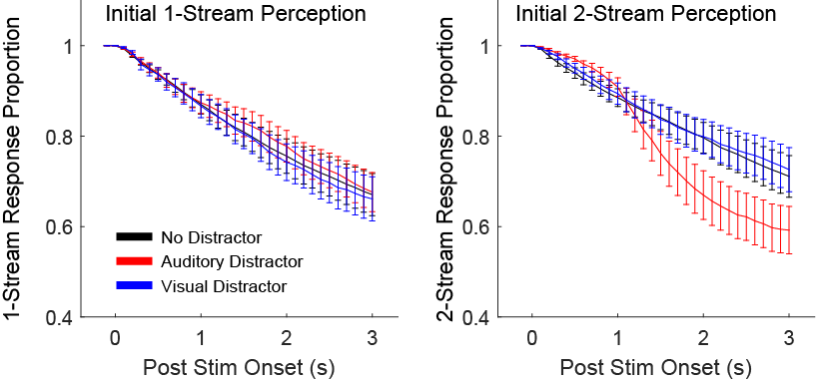
Induced switching paradigm
No effect of either distractor while perceiving 1 stream (left)
Auditory (but not visual) distractor resets perception from 2 streams back to 1 stream (right)
Suggests that resetting is due to central (high-level) interference (cf. Weintraub et al., 2014), but not due to attentional capture

Slide 20
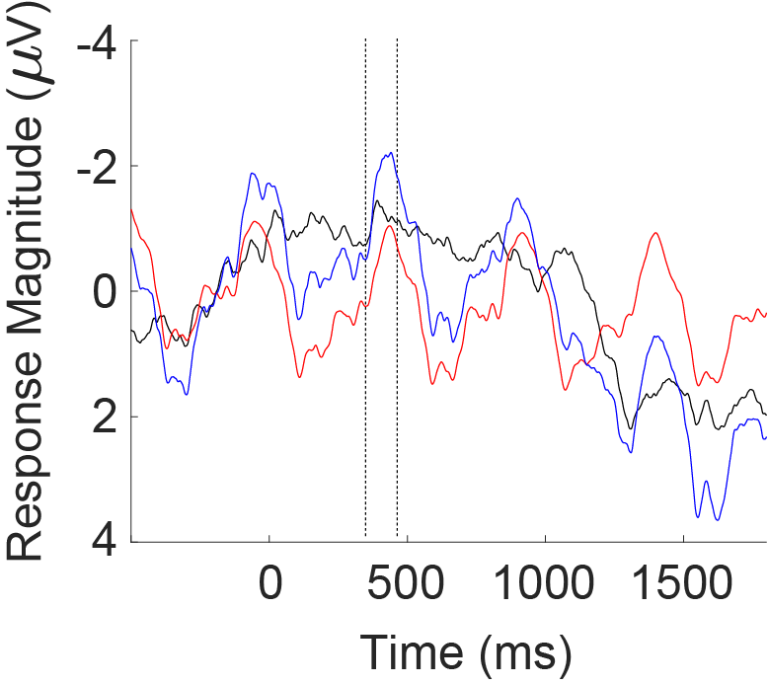
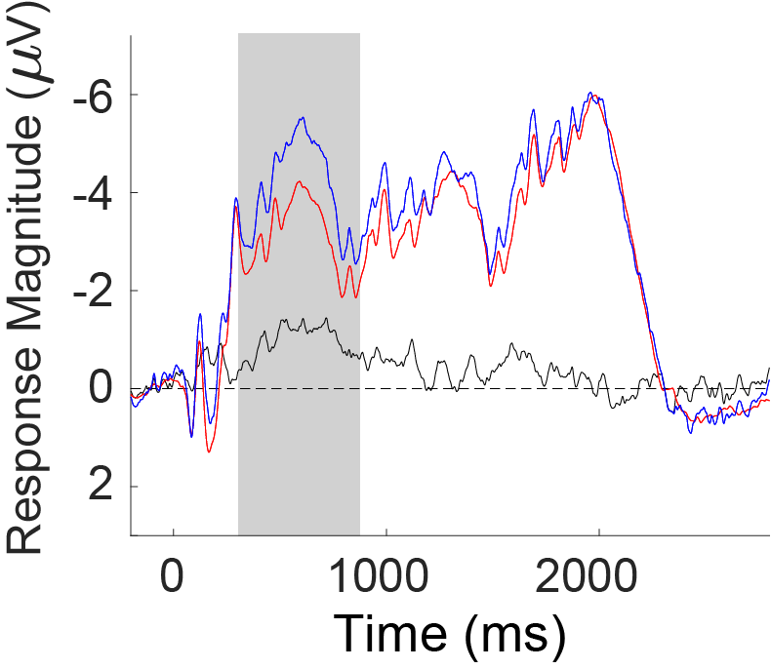

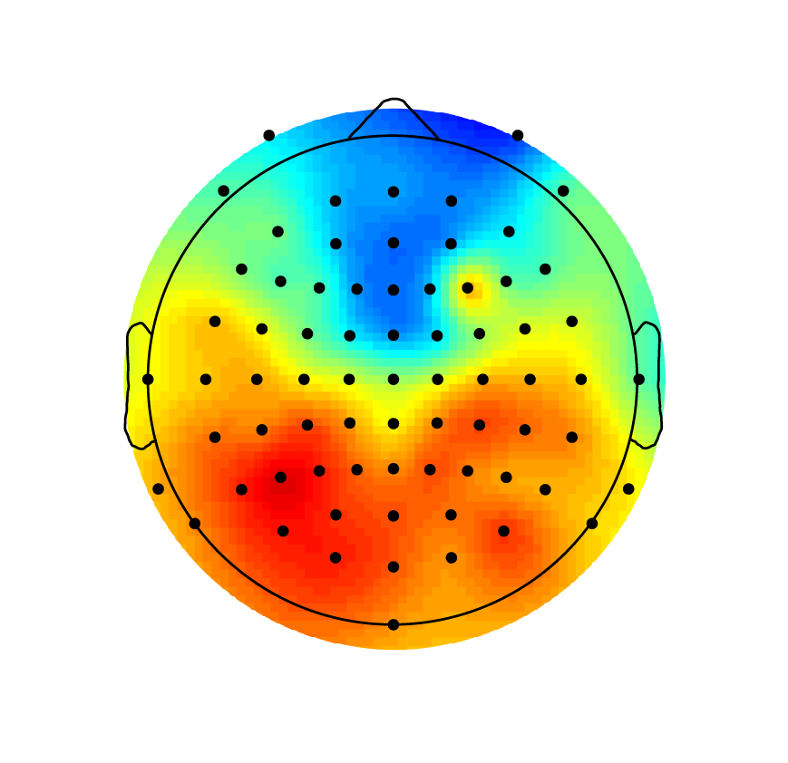
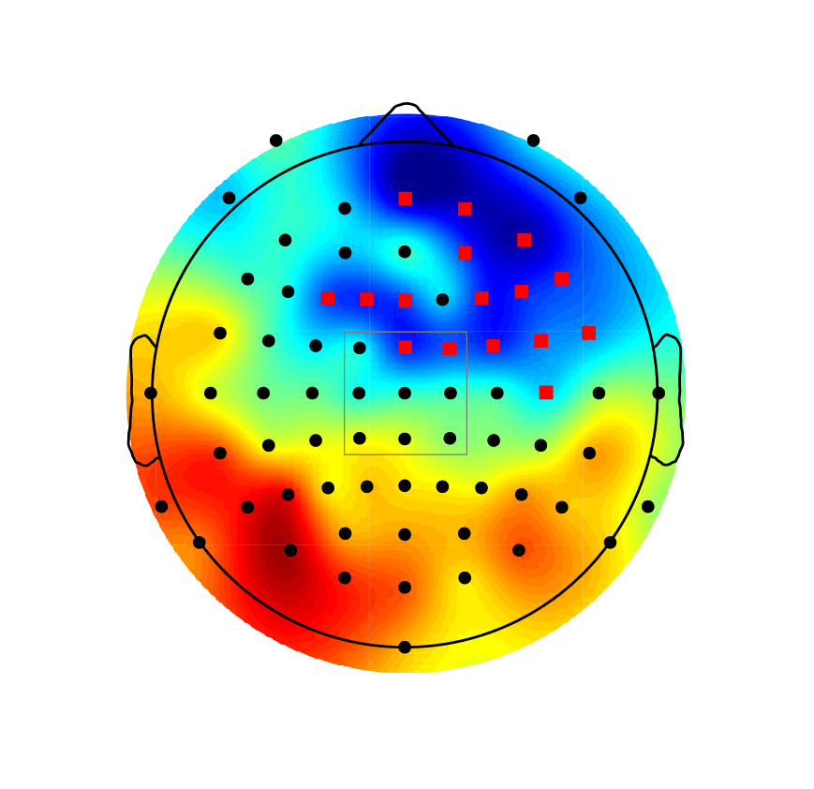
Induced switching paradigm
ERP difference for switch vs. no switch shows similar topography as in intermittent experiment
Distractor
Intermittent
switch-no switch
switch-no switch

Slide 21
Modeling Spontaneous Switches
Question: What components of scene analysis can plausibly contribute to spontaneous switches.
Approach: systematically introduce non-linear processes to individual components of a scene analysis model
Adaptation
Mutual-inhibition
Noise
Prior work: does not simultaneously model a full auditory perceptual pipeline and non-linear processes leading to bistability (e.g. Rankin 2015 et al, Mill et al 2013)
Notes:
Rankin – models adaptaiton, mutual-inhibition & noise over a simplified low-level representation of sound (3 frequency channels)
Mill et al – bypasses perceptual analysis and assumes input is chunked into discrete events (e.g. tones encoded as frequency and length)

Slide 22
Model Components
Notes:
The feature-level analysis involves two separate expansions of the auditory spectrogram
- an analysis by scales – looking at different spectral resolutions of the stimulus
- an analysis by rate – looking at different temporal resolutions of the stimulus

Slide 23
Model Components
Notes:
The object-level analysis has two stages
the first leads to simultaneous grouping – it uses matrix factorization methods to group features whose short-term temporal fluctuations correlate
the second leads to sequential grouping – it uses a Gaussian source model to greedily group segments from the first stage into a single continuous stream

Slide 24
Model Results
Notes:
By introducing non-linear mechanisms of adaptation, mutual inhibition and noise into the frequency-scale analysis we can generate bistability in this model.
The central graph shows how the different scales appear when these mechanisms are present.
When the slow-scale responses are emphasized, a one-stream percept is reported.
When the high-scale responses are emphasized, a two-stream percept is reported.

Slide 25
Summary & Conclusions
Preliminary evidence that perception of 1 vs. 2 streams is largely determined by auditory specific processes:
Auditory sustained potential (localized to superior temporal lobe) modulated by perceptual content AND switching
Auditory (but not visual) stimuli interfere with perception of 2 streams
Modeling shows that auditory-specific processing at multiple levels can explain bistable switching

Slide 26
Summary & Conclusions
Next steps:
Complete ERP experiment on distractors
Further source analysis of ERP experiments using dipoles and distributed methods (e.g., LORETA)
Evaluate model interactions (top-down <-> bottom-up) between components
Evaluate model on distractor-induced switches
fMRI experiment to identify brain areas associated with 2 streams vs. 1 stream and switching, and identify functional connectivity patterns between areas

Slide 27
Visual and auditory multistability
Many ambiguous stimuli show bistable (or multi-stable) switching patterns
Perception switches back and forth between different interpretations

Slide 28
Visual and auditory bistability
Sources in frontal and parietal areas could be also indicative of post-perceptual processing that does not directly correspond to true neural correlates of perception (cf. Shafto & Pitts, 2014)

Slide 29
Visual and auditory bistability
Studies of auditory bistability show activity in frontal and parietal areas that correlates with perceptual content (Cusack) or perceptual transitions (Kondo)
Cusack (2005)
Kondo et al. (2007)
Inf. PFC
Sup. PFC
ACC
sound>silence
2>1stream

